Slide 1

Team: 54 Ferris
CapStone Project
Team Members: Puja Patil
Heather Montey and
Fahad Shaikh
March 2021

Slide 2
Agenda
Strategy And Mission Statement
Review of Decisions
R&D
Marketing
Production
TQM
Finance
Review of Results
ROS
Market Share
Stock Price
Summary: Personal Reflections
Life Lessons

Slide 3



Strategy
Broad Differentiator
Broad Cost Leader
Niche Differentiator

Slide 4
Mission Statement
Premium, well designed products at a great price; our brands withstand the test of time while staying current technology at a great value. Our primary stockholders are customers, stockholders, bondholders, management and employees.

Slide 5
Our Products
Fast (Traditional)
Feat (Low-End)
Fist (High-End)
Foam (Performance)
Fume (Size)

Slide 6
Review of Decisions: R&D
Aligned all the products perfectly to gain market share
Successfully gained market share in the 1st Year
Focused on R&D completion dates
Didn’t produce a new product
MTBF cost saving factor

Slide 7
Review of Decisions: Marketing
Promotional Budget
1500 for 1st Half
High Awareness in round 1,2 and 3
Sales Budget
3000 for 1st half
High accessibility till round 5
High customer survey score
Pricing
50 cent rule

Slide 8
Review of Decisions: Production
Keeping Inventory carrying costs low
Maintaining Contribution Margins about 30%
Capacity
Keeping plant utilization between 100% - 180% by buying or selling capacity.
Increasing Automation as R&D timelines allowed

Slide 9
Review of Decisions: TQM
Spent aggressively in the first 3 years TQM was available to get the most benefit
Benefits are seen in the year they are placed and each year following
Maximum benefit is found by coordinating initiatives
Looked to gain benefit from all initiatives:
Reduce R&D cycle time
Reduce Labor & Material Costs
Reduce Administrative Costs

Slide 10
Review of Decisions: Finance
Used worst case scenario to estimate excess cash levels around $10 Million going into the rounds
Utilized Long-term and Short-term Loans heavily in the early years to allow for higher R&D costs and plant improvements
Choose not to issue stock in early rounds to maintain a higher stock price in later rounds.

Slide 11
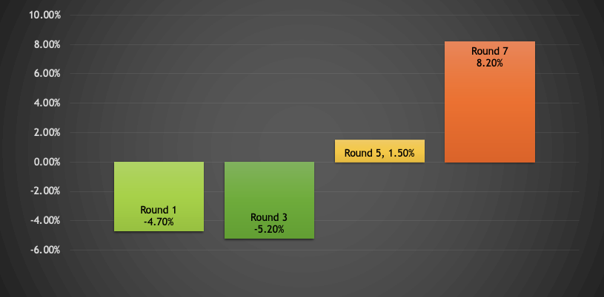
Review of Results: ROS
Notes:
ROS defines the amount of sales dollars the company kept as profit. To achieve an excellent rating, the company must maintain an ROS above 8%. Early on in the simulation Ferris faced negative ROS percentages, as a result of preparing the company for later rounds. Cash was heavily being put towards sales, capacity, and TQM initiatives to allow for reduced prices, labor costs, and material costs later in the simulation. Round 5 reflected the turn toward the positive as the company started to see results from the early push to convert excess assets to productive assets. Round 7 finally reached an ROS of 8.20%, as Ferris began to see a profit. Ferris could have improved the overall ROS by reducing initial debts earlier in the simulation, as well as watching price reductions in the later rounds to allow for a higher contribution margin. The debt Ferris carried from the early rounds was too much to overcome in the final rounds.
Ferris ended up around 4th for ROS with Teams Andrew, Baldwin, and Erie, but was making good progress on an upward trend with a 6.7% increase from Round 5 to Round 7 and ended with a ROS of 9.8% in Round 8.

Slide 12
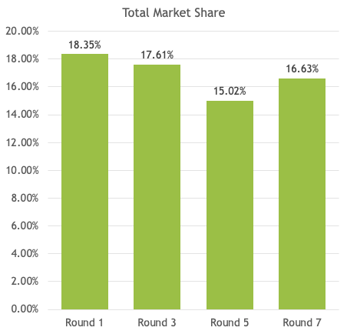
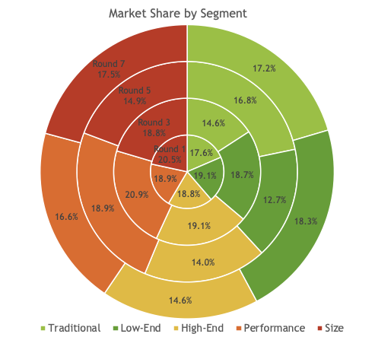
Review of Results: Market Share
Notes:
All company’s started out making up 16.67% of the Market. Ferris had a strong start raising to 18.35% in round 1, and continued to perform well through Round 3 falling slightly to 17.61% as a few new products moved into the Traditional Market. By round 5, the market was flooded with new products that spread between the Low-End and High-End segments, which caused Ferris market share to fall to 15.02%. As a result Team Ferris shifted their focus to price in combination with maintaining design, and increasing their promotional budget to recover more shares with less products. As a result by Round 7, Ferris had returned to 16.63% of the market.

Slide 13
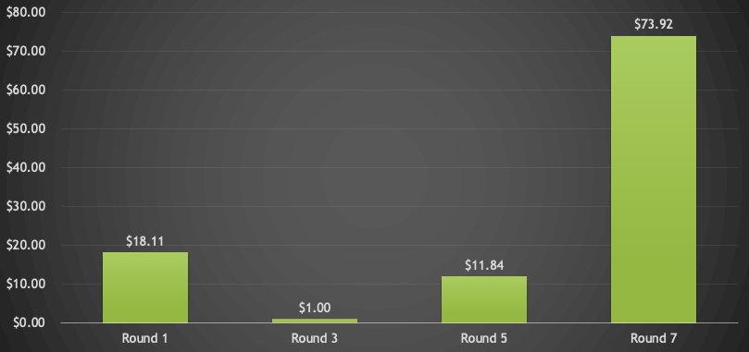
Review of Results: Stock Price
Notes:
Stock price is an indication of the growth potential of a company. In Round 1 the Stock Price Ferris had fallen from $34.25 to $18.11. At this point the stock price was still satisfactory, but continued decrease from there. As the stock price decreased, it became increasingly difficult for Ferris to make plant improvements. By Round 3 when Team Ferris would have liked to introduce product, the funds were not available to make all the necessary product adjustments and support TQM initiatives. Decisions were made to make the best of the products that we currently carried. As a result of this decisions costs were revaluated and changes were made to make sure the money being spent was working for the company. As a result, the stock price began to grow in Round 5, and had doubled the initial stock price by Round 7. This indicated that Ferris was moving in a positive direction, and the company would continue to grow in future rounds.

Slide 14
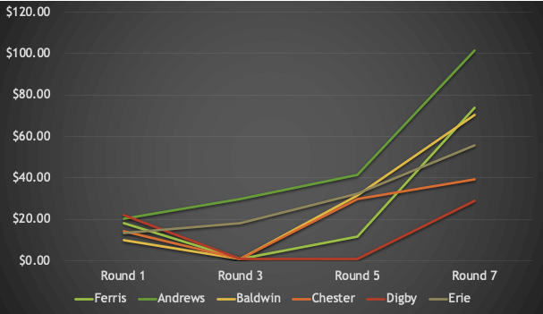
Review of Results: Stock Price
Notes:
As a result of the readjustments Ferris made we were able to move into second place for Stock Price behind Team Andrews by Round 7 and able to hold this position through Round 8. This meant that investors were noticing and liking the adjustments made and saw potential in Ferris moving forward.

Slide 15
Summary: Life Lessons
Lesson 1: Your first plan is never your last; Your strategy must be flexible and adaptive to remain competitive.
Lesson 2: Silos must be removed to allow for coordinated, strategic, and successful decisions to be made within a company.
Lesson 3: Teams achieve more when their is not a Hero!

